Slide 1
Online Retail Customer
5,942
Customers
Churn Analysis
24 mo
Time period
1,067,371
Transactions
Github=Abdu1mannan

Slide 2
CONTEXT
Business Problem & Dataset Profile
Objective
1,067,371
5,942
This business loses nearly half its customers within a two-year window. The project identifies which customers churn, why they churn, and which active customers are at highest risk of lapsing. The output informs a tiered retention strategy.
Raw Transactions
Unique Customers
Dec 2009
Dec 2011
Churn Definition
Period Start
Period End
A customer is classified as churned if no transaction was recorded in the four months before the cutoff date of August 9, 2011.
243K
4 Months
Toolchain
Null IDs Excluded
Inactivity Threshold
SQL
Feature engineering and aggregation across 1M+ rows
Negative unit prices removed. Returns retained as net quantity adjustments.
Python
EDA, segmentation, logistic regression
Power BI
Three-page interactive dashboard

Slide 3
METHODOLOGY
End-to-End Analysis Pipeline
01 Raw Data
02 SQL
03 Python
04 Power BI
1,067,371 transactions
Feature Engineering
EDA + Modeling
Dashboard
UK-based online retailer
Null ID exclusion
Distribution analysis
Executive Summary
Dec 2009 to Dec 2011
»
Negative price removal
»
Segmentation (RFM tiers)
»
Segment Analysis
5,942 Customers
12 features per customer
Logistic regression
Risk Scoring

Slide 4
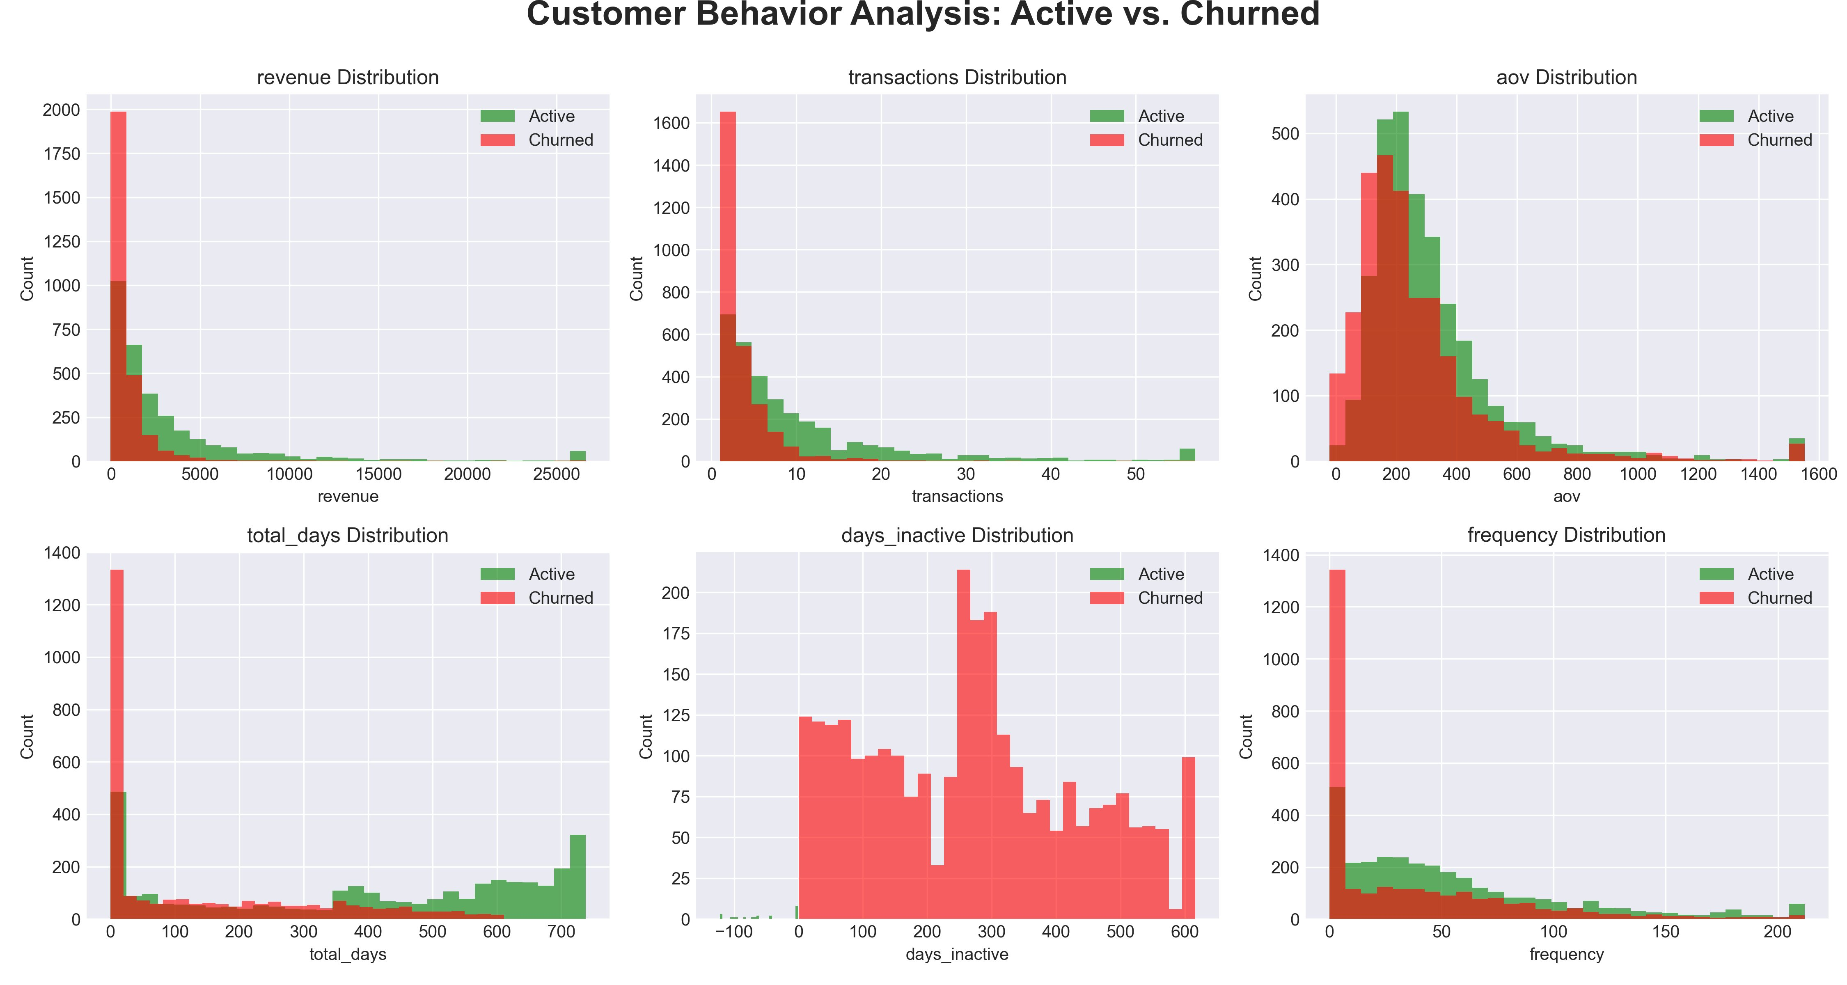
EXPLORATORY ANALYSIS
Feature Distributions: Active vs. Churned Customers (Python EDA)
Green: Active | Red: Churned | Generated in Python (matplotlib)

Slide 5
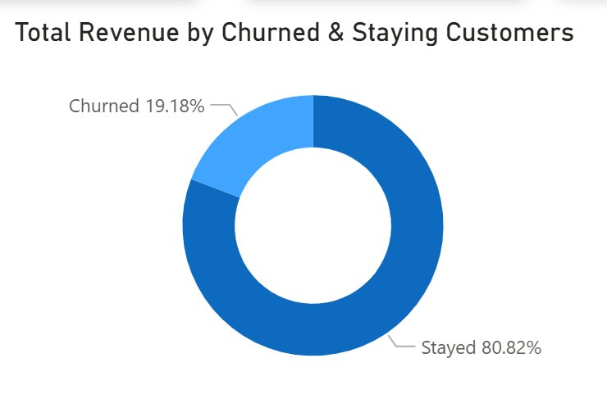
Executive Summary
Churn Overview
5,942
2,782
3,160
46.82%
$13.08M
Total Customers
Churned
Active
Churn Rate
Total Revenue (24 mo)
Revenue Impact
46.82% of customers churned. Despite this, churned customers account for only 19.18% of total revenue. The gap is structural: customers who leave are disproportionately from the lowest revenue and lowest frequency segments.
What this means
The churn problem is volume-heavy, not value-heavy.
Premium and Frequent buyers show strong retention.
$159.91K in active-customer revenue is at risk from customers with churn probability above 70%.

Slide 6
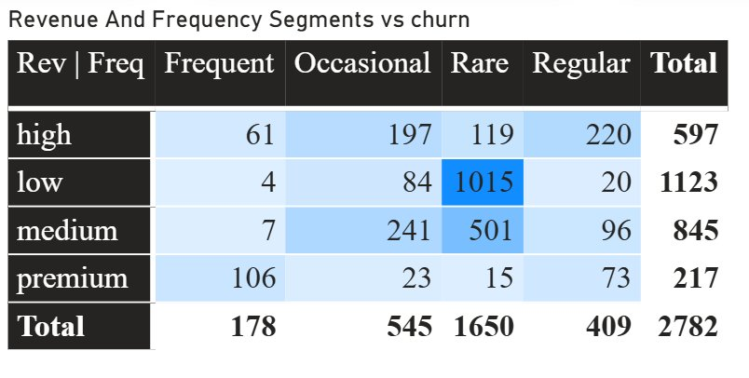
SEGMENT ANALYSIS
Churn Concentration by Revenue and Frequency
1,015
Low | Rare churned
36.5% of all churn in a single cell
501
Medium | Rare churned
Second-largest concentration
1,650
Total Rare churners
59.3% of all churn is Rare-frequency
Key Pattern
Churn is not evenly distributed. Two cells (Low|Rare and Medium|Rare) account for 54.5% of all churned customers. Frequent buyers across all revenue segments show the lowest churn rates. Retention spend should be concentrated here, not spread uniformly.

Slide 7
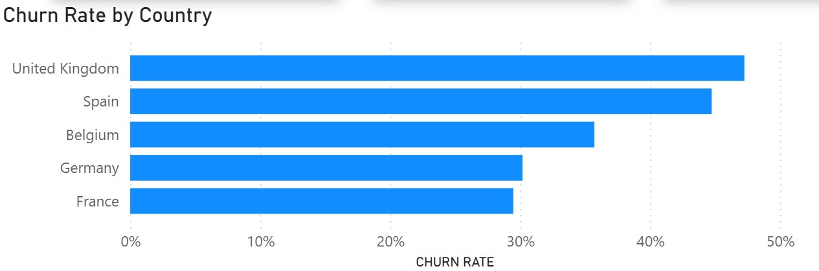
SEGMENT ANALYSIS
Geographic Distribution
UK represents ~75% of all customers. Aggregate findings reflect UK behavior.
Non-UK churn rates are directionally useful but statistically weak given sample sizes.
Spain at 41.46% is the only non-UK market with a comparably high churn rate.

Slide 8
PREDICTIVE MODEL
Logistic Regression: Setup and Feature Importance
Model Configuration
Algorithm
Logistic Regression
Train / Test
80% / 20%, stratified
Scaler
StandardScaler
Features
7 (days inactive excluded)
Accuracy
71%
Data Leakage Correction
The initial model included days nactive (98% accuracy). This feature is derived directly from the churn label, making the result circular(data leakage). It was removed. The revised model uses behavioral features only.
Negative = protective (reduces churn risk) Positive = risk factor (increases churn risk)

Slide 9
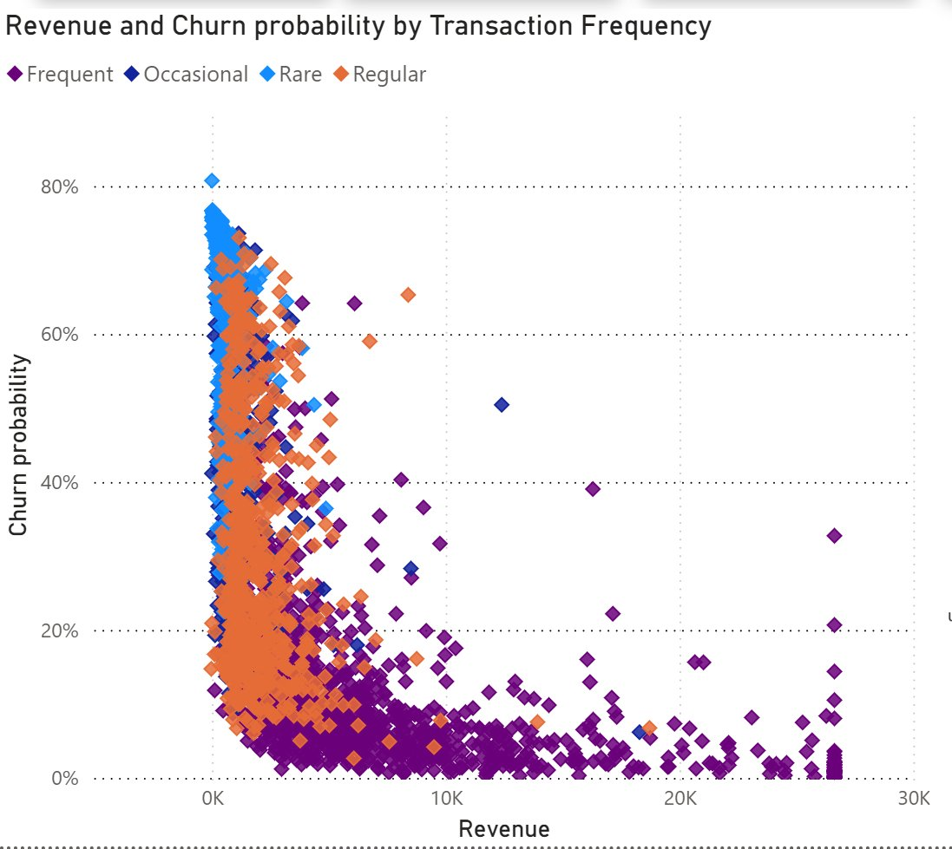
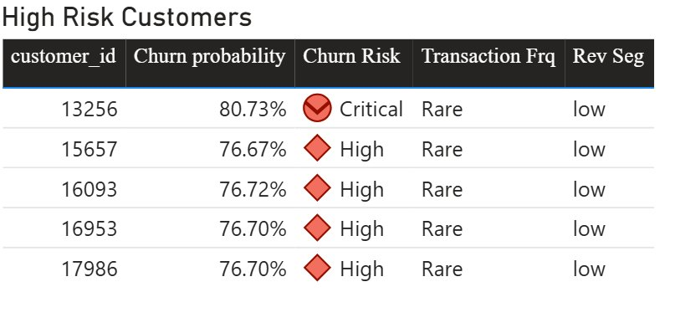
RISK ANALYSIS
Customer Risk Scoring
34.14%
781
$204.75
$159.91K
Avg Churn Probability (Active)
High / Critical Risk Customers
Avg Revenue: High-Risk
Total Revenue at Risk
Scatter Interpretation
Rare customers cluster at high churn probability and low revenue: maximum risk, minimum value.
Frequent buyers (purple) sit at low probability across the full revenue range.
A strong inverse curve confirms revenue is protective even controlling for frequency.

Slide 10
RECOMMENDATIONS
Retention Strategy by Segment
Low | Rare
Medium | Rare
High Volume
Second-Largest Pool
Automated email reactivation with minimum order discount. No account management resources. Cost of retention must stay below customer value.
Category-targeted promotions based on purchase history. Priority: increase transaction frequency before revenue growth.
High-Risk Active (prob > 0.70)
Frequent | Premium
Immediate Priority
Maintain
Export high-risk table from dashboard. Outbound retention campaign within 30 days. Focus on customers with revenue above $500.
No active intervention required. Monitor for anomalous inactivity. Maintain fulfillment quality.

Slide 11
LIMITATIONS
Known Constraints
Limitations
Multicollinearity: frequency is algebraically derived from total days and transactions. Coefficient magnitudes are unreliable; directions are not.
No demographic data: acquisition channel, price sensitivity, and returns experience are absent from the model.
UK dominance: 75% UK customers means non-UK segment findings cannot be generalised.
Static threshold: a fixed 4-month cutoff misclassifies seasonal buyers as churned.
Model ceiling: logistic regression at 71% cannot capture non-linear churn dynamics.

